Slide 1
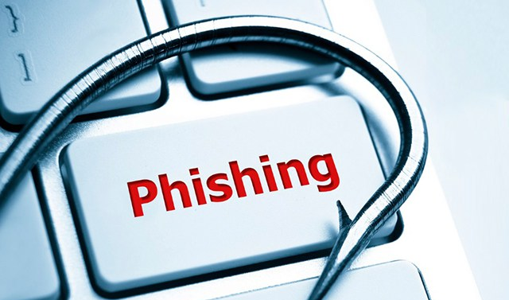
Phishing Awareness training
Learn:
how to Recognize emails & fake websites
The social engineering tactics used by the attackers
Best practices and tips to avoid falling victim
Real-world examples
Interactive quizzes
This Photo by Unknown Author is licensed under CC BY-SA-NC

Slide 2
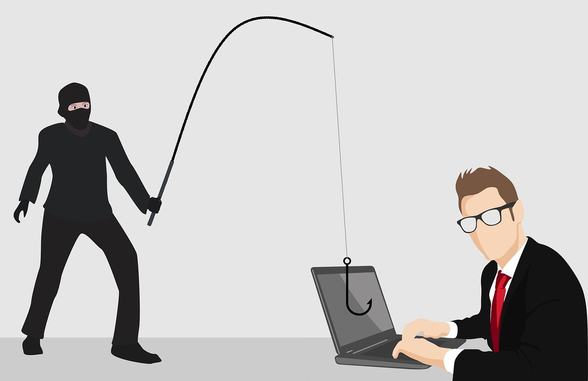
HOW TO RECOGNIZE PHISHING EMAILS AND FAKE WEBSITES?
What is Phishing?
Phishing is a deceptive practice where cybercriminals try to trick you into revealing sensitive information, such as passwords, credit card numbers, or social security numbers. They do this by pretending to be a trustworthy entity, like a bank, a well-known company, or a government agency.

Slide 3

Recognizing Phishing Emails:
Phishing emails often create a sense of urgency or fear to make you act without thinking. Here are the key indicators to watch out for:
1. Examine the Sender's Email Address: This is one of the most reliable indicators. A legitimate company's email address will almost always use their official domain name. Phishing emails will use a domain that is slightly different, often with a typo, an extra word, or a different suffix.
Legitimate: support@yourbank.com
Phishing: support@yourbank-secure.net or yourbank.com.login@gmail.com
Always check the full email address, not just the name displayed in your inbox.
This Photo by Unknown Author is licensed under CC BY-SA-NC

Slide 4
Recognizing Phishing Emails:
2. Look for Typos and Grammatical Errors: Reputable organizations have professional communication teams that carefully craft their emails. Phishing emails, on the other hand, frequently contain spelling mistakes, incorrect punctuation, and awkward phrasing. These errors are a significant red flag.
3. Sense of Urgency or Threats: Phishers often use alarming language to pressure you into taking immediate action. Phrases like "Your account will be suspended," "Urgent: Your payment is due," or "Your password has expired" are designed to create panic and bypass your critical thinking.
4. Suspicious Links and Attachments: Be extremely cautious about clicking links or downloading attachments.
Hover over links: Before you click, hover your mouse over the link to see the actual URL in the bottom corner of your browser. If the URL doesn't match the company's official website, do not click it.
Unexpected attachments: Avoid opening attachments from emails you weren't expecting, especially if they are a common file type for malware, such as .exe or .zip files.
This Photo by Unknown Author is licensed under CC BY-SA-NC

Slide 5
Recognizing Phishing Emails:
5. Requests for Personal Information: Legitimate companies will rarely, if ever, ask for sensitive information like your password, social security number, or credit card details via email. If an email asks for this kind of data, it is almost certainly a phishing attempt.
This Photo by Unknown Author is licensed under CC BY-SA-NC

Slide 6
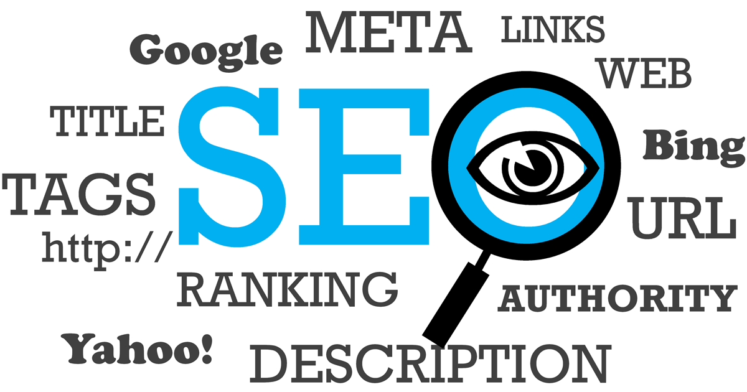
Recognizing Fake Websites:
Phishing websites are designed to look identical to legitimate ones to trick you into entering your credentials or personal information. Here’s how to spot a fake:
1. Check the URL Carefully: The website's address is your best defense.
HTTPS and Padlock: Look for https:// at the beginning of the URL and a padlock icon in the address bar. The "s" stands for "secure" and indicates an encrypted connection. However, many fake sites now use HTTPS, so this alone is not enough to guarantee legitimacy.
Typo-squatting: Check for misspellings in the domain name. For example, www.amaz0n.com (using a zero) or www.amason.com instead of www.amazon.com.
Incorrect Domain: Ensure the domain name is correct. Attackers often use subdomains to deceive you (e.g., paypal.login.secure-account.com). The true domain is the part directly before the .com, .org, or another top-level domain. In this example, the real domain is secure-account.com, not PayPal.

Slide 7
Recognizing Fake Websites:
2. Low-Quality Design: While many fake websites are professionally designed, some may have subtle flaws. Look for:
Low-resolution or pixelated logos.
Inconsistent fonts or colors.
Non-functional links or buttons (e.g., "About Us" or "Contact" pages that don't lead anywhere).
3. Suspicious Pop-ups: Some fake sites use pop-up windows that are not part of the standard design, often asking for personal information or credentials. Close these pop-ups and leave the site.
4. Request for Unnecessary Information: Be suspicious if a website asks for information that is not typically required. For example, a login page that requests your social security number, mother's maiden name, or full credit card details.
By staying alert and verifying these details, you can significantly reduce your risk of falling victim to phishing scams.

Slide 8
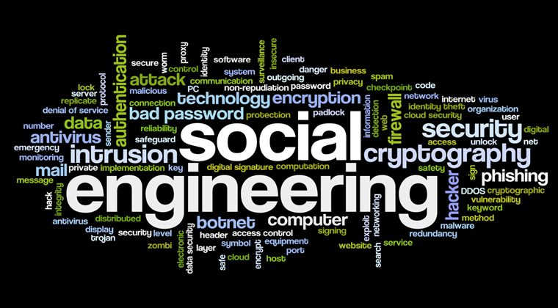
SOCIAL ENGINEERING TACTICS USED BY THE ATTACKERS:
What is Social Engineering?
Social engineering is the art of manipulating people to give up confidential information or perform actions that they shouldn't. It's often referred to as "human hacking" because it exploits psychological principles rather than technical vulnerabilities. Attackers use a variety of tactics to play on human emotions like fear, greed, curiosity, and a desire to be helpful.

Slide 9
MOST COMMON SOCIAL ENGINEERING TACTICS USED BY ATTACKERS:
1. Phishing:
Phishing is the most widespread social engineering attack. Attackers use deceptive messages to trick victims into revealing sensitive information or installing malware.
Email Phishing: The most common form, where attackers send fraudulent emails that appear to be from a legitimate company or individual. They often contain links to fake websites or malicious attachments.
Spear Phishing: A highly targeted form of phishing. Attackers research a specific individual to make the email seem more personal and credible. For example, an attacker might learn about your work and send a fake email that looks like it's from your boss, a colleague, or a vendor you work with.
Whaling: A type of spear phishing that targets high-profile individuals, such as CEOs or CFOs. Attackers go after these "big fish" because they have access to highly sensitive information and can authorize large financial transfers.
Smishing (SMS Phishing): Phishing attacks conducted via text message. The messages often contain malicious links or urgent requests to call a fraudulent number.
Vishing (Voice Phishing): Phishing attacks that use phone calls. An attacker might impersonate a bank representative, a government agent, or an IT support professional to trick you into giving them your information over the phone.

Slide 10
MOST COMMON SOCIAL ENGINEERING TACTICS USED BY ATTACKERS:
2. Pretexting:
Pretexting involves creating a believable, fabricated scenario (a "pretext") to gain a victim's trust and obtain information.
The attacker will usually impersonate a person in a position of authority or someone who has a legitimate reason to ask for the information.
Example: An attacker calls an employee at a company and pretends to be from the IT department. They claim there's an issue with the employee's computer and need their password to "fix it." The employee, wanting to be helpful and believing the attacker is a trusted professional, gives them the information

Slide 11
MOST COMMON SOCIAL ENGINEERING TACTICS USED BY ATTACKERS:
3. Baiting:
Baiting relies on an attacker's promise of something desirable to tempt a victim into a trap. This tactic often appeals to a person's greed or curiosity.
Online Baiting: Attackers use online advertisements that promise free movies, music, or software downloads. When the victim clicks the ad, they are often led to a malicious website that installs malware or asks for personal information.
Physical Baiting: An attacker might leave a malware-infected USB drive in a public place, like an office parking lot, with a tempting label like "2025 Salaries" or "Confidential." A curious employee might pick it up and plug it into their computer, unwittingly infecting the network.

Slide 12
MOST COMMON SOCIAL ENGINEERING TACTICS USED BY ATTACKERS:
4. Quid Pro Quo:
This tactic is a type of social engineering where an attacker offers a "favor" or a service in exchange for information.
Example: An attacker calls a company and pretends to be an IT professional offering free tech support to employees. When an employee takes them up on the offer, the attacker says they need the employee's credentials to "troubleshoot" the issue, gaining access to their account.

Slide 13
MOST COMMON SOCIAL ENGINEERING TACTICS USED BY ATTACKERS:
5. Scareware:
Scareware uses fear to trick a victim into taking a specific action, usually by creating a fake threat.
Example: A user is browsing the web when a pop-up window appears, flashing red and claiming their computer is infected with a dangerous virus. The message urges the user to immediately download a specific "antivirus" program to fix the problem. The program is actually malware, and the pop-up is a lie.

Slide 14
MOST COMMON SOCIAL ENGINEERING TACTICS USED BY ATTACKERS:
6. Tailgating (or Piggybacking):
This is a physical social engineering tactic where an unauthorized person follows an authorized person into a restricted area.
Example: An attacker waits by a secure door and, as an employee swipes their badge and opens the door, the attacker quickly walks in right behind them. They might pretend to be on their phone or carrying a large stack of boxes to make it seem like they can't use their own badge, and the employee, out of politeness, holds the door open.

Slide 15

BEST PRACTICES AND TIPS TO AVOID FALLING VICTIM:
Building on the previous explanation of social engineering tactics, here are the best practices and tips to avoid falling victim to these attacks. The core principle is to develop a healthy sense of skepticism and to treat all unsolicited requests for information with caution.
1. Be Skeptical and Verify Everything
Don't Rush. Attackers rely on a sense of urgency. If an email or message demands immediate action, pause and think. Take your time to verify the request.
Independent Verification. Never use the contact information provided in a suspicious message. Instead, find the official phone number or website for the company or person in question through a separate source, like their official website or a trusted directory.
Verify the Source. If your "boss" emails you with an unusual request for a wire transfer, call them on a number you know is correct to confirm the request.
Don't simply reply to the email.

Slide 16
BEST PRACTICES AND TIPS TO AVOID FALLING VICTIM:
2. Practice Good Cyber Hygiene
Use Strong, Unique Passwords. Use a different password for every online account. If one account is compromised, the others will remain secure. A password manager can help you manage these.
Enable Multi-Factor Authentication (MFA). This is one of the most effective defenses against social engineering. Even if an attacker gets your password, they won't be able to access your account without a second verification factor (like a code from your phone).
Keep Software Updated. Ensure your operating system, web browsers, and antivirus software are always up-to-date. These updates often contain critical security patches that protect against new vulnerabilities.
Install Antivirus/Anti-Malware Software. A good security suite can detect and block malicious software that might be installed through a social engineering attack.

Slide 17
BEST PRACTICES AND TIPS TO AVOID FALLING VICTIM:
3. Be Smart About Links and Attachments
Hover Before You Click. Before clicking on a link in an email, hover your mouse cursor over it. The actual destination URL will appear, usually at the bottom of your browser window. Check for any inconsistencies, typos, or unfamiliar domains.
Don't Open Unexpected Attachments. If you receive an attachment you weren't expecting, even from someone you know, contact the sender through a different channel to confirm they sent it.
Check the URL for HTTPS and the Padlock Icon. Always look for https:// at the beginning of a website's URL and a padlock icon.
This indicates a secure, encrypted connection. However, remember that some phishing sites now use HTTPS, so this isn't a guarantee of legitimacy.

Slide 18
BEST PRACTICES AND TIPS TO AVOID FALLING VICTIM:
4. Protect Your Personal Information
Limit Public Information. Be mindful of what you share on social media. Attackers can use details like your birth date, your first pet's name, or your place of birth to craft convincing phishing attacks or to guess the answers to your security questions.
Be Wary of Over-Sharing. Avoid sharing too much personal or professional information in public forums or with strangers online. This information can be used to build a "pretext" for a social engineering attack.
5. Educate Yourself and Others
Learn to Recognize Red Flags. The more you understand social engineering tactics, the better you'll be at spotting them. Share this knowledge with your family and friends.
Report Suspicious Activity. If you receive a phishing email or encounter a fake website, report it to your IT department (if it's a work-related issue), your email provider, or the relevant authorities. Reporting helps protect others from falling victim to the same scams.

Slide 19

SOME REAL-WORLD EXAMPLES:
Social engineering is not a theoretical threat; it has been the root cause of some of the most significant and costly cyberattacks in history. These real-world examples show how attackers exploit human psychology to bypass even the most advanced technological defenses.
1. The Google and Facebook Phishing Scam (2013-2015)
This is a classic and highly impactful example of a Business Email Compromise (BEC) scam. An attacker, Evaldas Rimasauskas, impersonated a legitimate Taiwanese electronics manufacturer, Quanta Computer Inc., that supplied both Google and Facebook. He meticulously crafted fake invoices and emails and sent them to employees at both companies.
The Tactic: The attacker used a convincing pretext, creating a fake company with a name very similar to the legitimate vendor. The emails were so well-crafted and targeted that employees at both tech giants were deceived into wiring over $100 million to fraudulent bank accounts.
The Outcome: The scam lasted for two years before it was discovered. The fact that two of the world's most sophisticated tech companies fell for this simple social engineering trick highlights how effective these attacks can be when they exploit human trust and flawed internal processes.

Slide 20
SOME REAL-WORLD EXAMPLES:
2. The Twitter Bitcoin Scam (2020)
This attack was a blend of social engineering and technical hacking. Attackers gained access to Twitter's internal tools by targeting a small number of employees through a spear-phishing attack.
The Tactic: The attackers used a combination of pretexting and vishing to trick employees into giving up their credentials. They posed as colleagues or IT support to gain access to internal systems. Once inside, they took control of high-profile Twitter accounts belonging to celebrities and public figures like Elon Musk, Barack Obama, and Bill Gates.
The Outcome: The attackers used these compromised accounts to post a bitcoin scam, promising to double any bitcoin sent to a specific address. The scam netted over $100,000 in cryptocurrency, but the damage to Twitter's reputation and security was far more significant. This example showed that even a single employee falling for a social engineering attack can have massive, far-reaching consequences for an entire company.

Slide 21
SOME REAL-WORLD EXAMPLES:
3. The Colonial Pipeline Ransomware Attack (2021)
This attack demonstrated how social engineering can be the initial access point for a large-scale cyberattack on critical infrastructure. The attack vector used by the DarkSide gang was a phishing email.
The Tactic: An employee at Colonial Pipeline was targeted with a phishing email. The attacker gained access to the employee's login credentials, which did not have multi-factor authentication (MFA) enabled. This gave the attackers an easy way into the company's network.
The Outcome: Once inside, the attackers deployed ransomware that shut down the pipeline's operations for several days, leading to widespread fuel shortages and panic buying across the U.S. East Coast. This attack highlighted the critical importance of simple security measures like MFA and employee training to prevent catastrophic outcomes.

Slide 22
SOME REAL-WORLD EXAMPLES:
4. The Stuxnet USB Attack (2009)
This is a famous example of physical baiting, though it was part of a state-sponsored cyber-espionage operation. The Stuxnet computer worm was designed to sabotage Iran's nuclear program.
The Tactic: The malware was believed to have been introduced into a secure Iranian nuclear facility via an infected USB flash drive. Attackers likely left the USB drive in a location where a curious employee would find it and plug it into a computer connected to the facility's network.
The Outcome: Once inside, Stuxnet spread through the network, ultimately gaining access to the control systems for the facility's uranium enrichment centrifuges. The worm subtly altered the centrifuges' spin rates, causing them to fail over time without any alarms or indications to the operators. This attack proved that even air-gapped networks (networks not connected to the internet) are vulnerable to social engineering.

Slide 23

INTERACTIVE QUIZZES:
1. What is the primary psychological tactic used in social engineering?
A. Manipulating human emotions and trust
B. Exploiting network vulnerabilities
C. Brute-forcing passwords
D. Using ransomware to encrypt files
2. An attacker creates a fake LinkedIn profile to connect with an employee and gather information about their company. What social engineering tactic is this an example of?
A. Phishing
B. Smishing
C. Pretexting
D. Baiting

Slide 24
INTERACTIVE QUIZZES:
3. Which of the following is the most effective defense against a social engineering attack that uses stolen passwords?
A. Never using the internet
B. Using a simple password
C. Enabling Multi-Factor Authentication (MFA)
D. Disabling your email account
4. You receive an email from a supposed IT department requesting your password to perform an 'urgent system update.' What is the best course of action?
A. Call the IT department using a phone number you know is official to verify the request
B. Ignore the email and hope it's not a scam
C. Click the link in the email to go to the 'update' page
D. Reply to the email and provide your password

Slide 25
INTERACTIVE QUIZZES:
5. An attacker leaves a USB drive labeled 'Q4 Employee Salary Data' in a company's parking lot. This is an example of which social engineering tactic?
A. Phishing
B. Vishing
C. Pretexting
D. Baiting
6. What is the primary difference between phishing and spear phishing?
A. Phishing aims to install malware, while spear phishing aims to steal data.
B. Phishing uses email, while spear phishing uses text messages.
C. Phishing targets a small group, while spear phishing targets a large group.
D. Phishing is a generic attack, while spear phishing is highly targeted toward a specific individual or organization.

Slide 26
INTERACTIVE QUIZZES:
7. You receive a text message stating that your bank account has been locked and you must click a link to unlock it. What social engineering tactic is this an example of?
A. Phishing
B. Vishing
C. Smishing
D. Tailgating
8. A person impersonating a delivery driver asks an employee to hold the door open for them to enter a secure office building. What is this tactic called?
A. Tailgating
B. Scareware
C. Pretexting
D. Watering hole attack

Slide 27
INTERACTIVE QUIZZES:
9. The Google and Facebook scam where a fraudster sent fake invoices is a prime example of which type of attack?
A. Baiting
B. Vishing
C. Business Email Compromise (BEC)
D. CEO Fraud
10. A social engineering attack that targets a website a specific group of people is known to visit is called a:
A. Quid pro quo attack
B. Scareware attack
C. Watering hole attack
D. Spear phishing attack

Slide 28

ANSWERS:
1: A. Manipulating human emotions and trust
2: C. Pretexting
3: C. Enabling Multi-Factor Authentication (MFA)
4: A. Call the IT department using a phone number you know is official to verify the request
5: D. Baiting
6: D. Phishing is a generic attack, while spear phishing is highly targeted toward a specific individual or organization.
7: C. Smishing
8: A. Tailgating
9: C. Business Email Compromise (BEC)
10: D. Watering hole attacK

